Slide 1
Red-Blue Team Simulation with OSSIM SIEM
ECE4309.01 | Fall 2023 | Dr. Formicola
Christy Xiong
Jake Davila Jonathan Hanbali
Nina Fajardo
Virgil Nhieu

Slide 2

01
Background

Slide 3


What is Red-Blue Team Simulation & OSSIM SIEM?
Calera - An attack and defense simulation game in Linux
Consists of two teams
Red Team - Attacking the victim computer
Blue Team - Defending the victim computer
OSSIM - Security Information and Event Management to track the events going on with the victim

Slide 4
02
Our Setup

Slide 5
Our Network
Red Team
Blue Team & OSSIM SIEM were on VMs.
Red Team starts server for Caldera.
Blue Team connects to server.
Additional Laptop with OSSIM SIEM connected to Caldera server to monitor traffic.
Red Team begins automated operation.
Attacking
Target PC
OSSIM SIEM
Observing
Defending
Blue Team

Slide 6
03
Lazarus Group & Equation Group

Slide 7
Lazarus Group and Equation Group
 | Lazarus Group | Equation Group
APT Group ID | G0032 | G0020
Who | North Korean state-sponsored cyber threat group | More than 300 domains and more than 100 servers in multiple countries, using C&C infrastructure
Known for | November 2014 destructive wiper attack against Sony Pictures Entertainment | zero-day exploits, overwrite the firmware of hard disk drives
Active Since | At least 2009 | Since 2001
Associated Groups | Labyrinth Chollima, HIDDEN COBRA, Guardians of Peace, ZINC, NICKEL ACADEMY
Notes:
Equation Group: The Crown Creator of Cyber-Espionage | Kaspersky

Slide 8
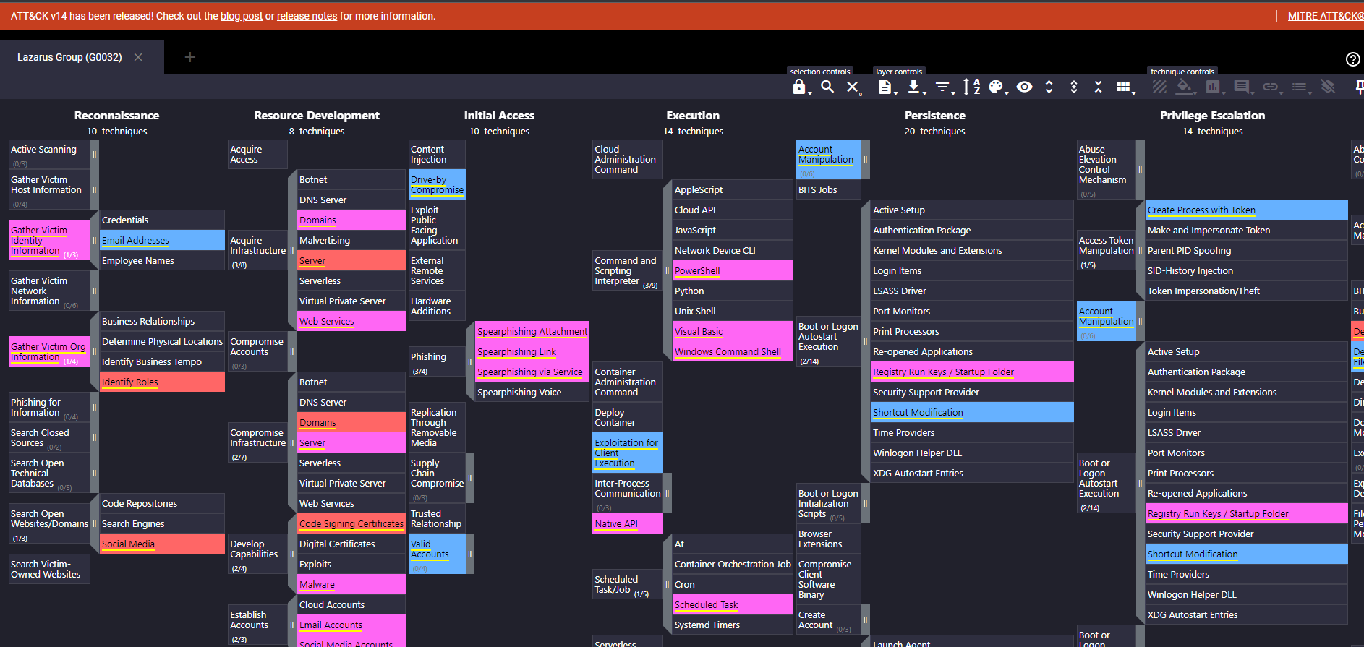
Lazarus Group Attack Model

Slide 9
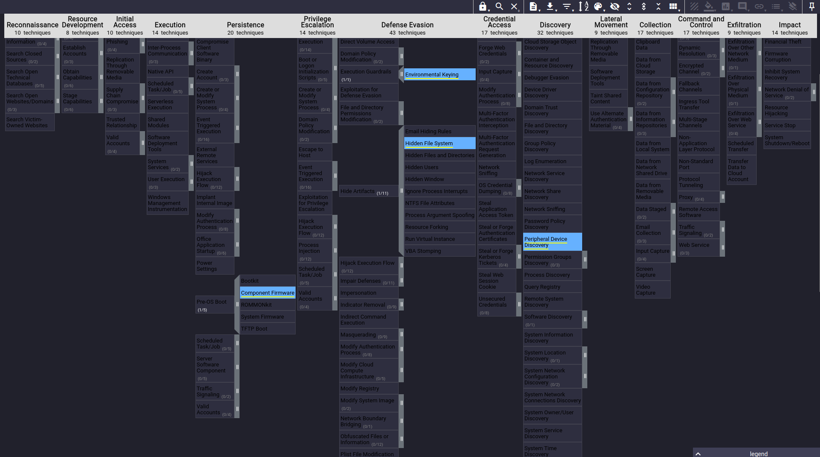
Equation Attack Model

Slide 10
04
Red-Team Adversary

Slide 11
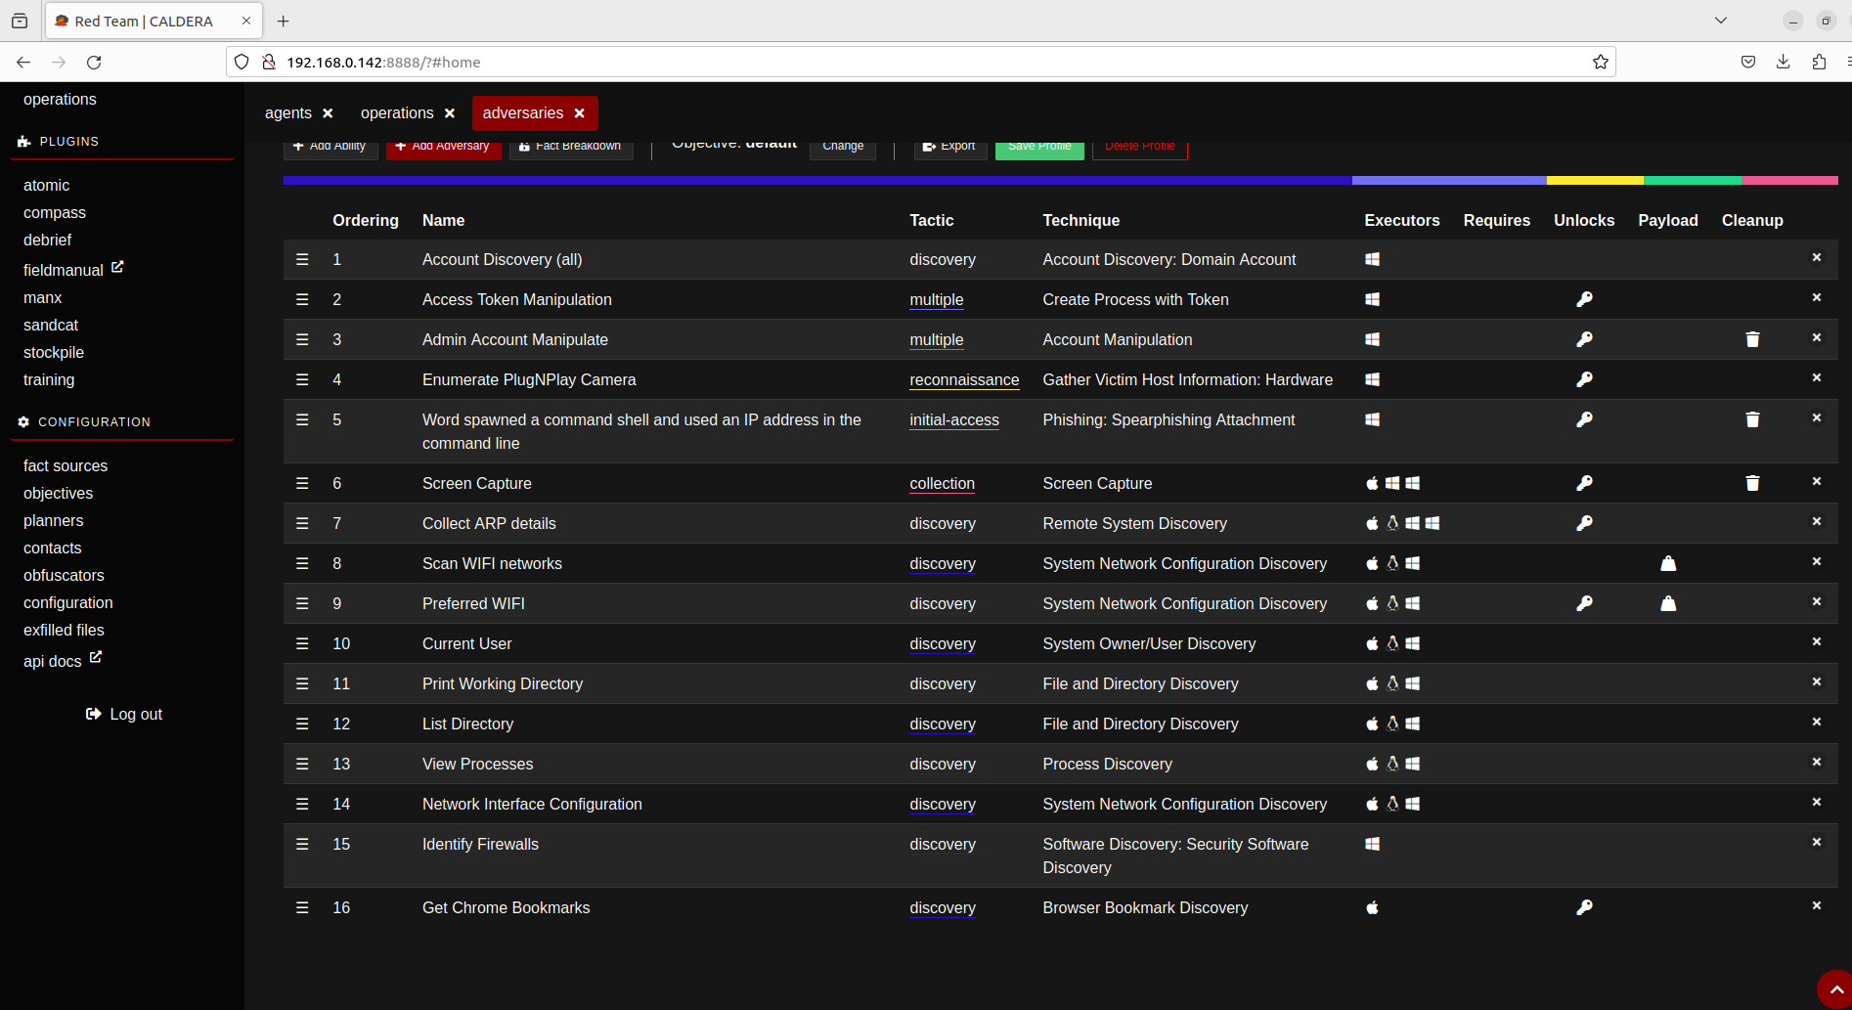
Caldera - Red Team
Adversary profile created by Red Team.

Slide 12
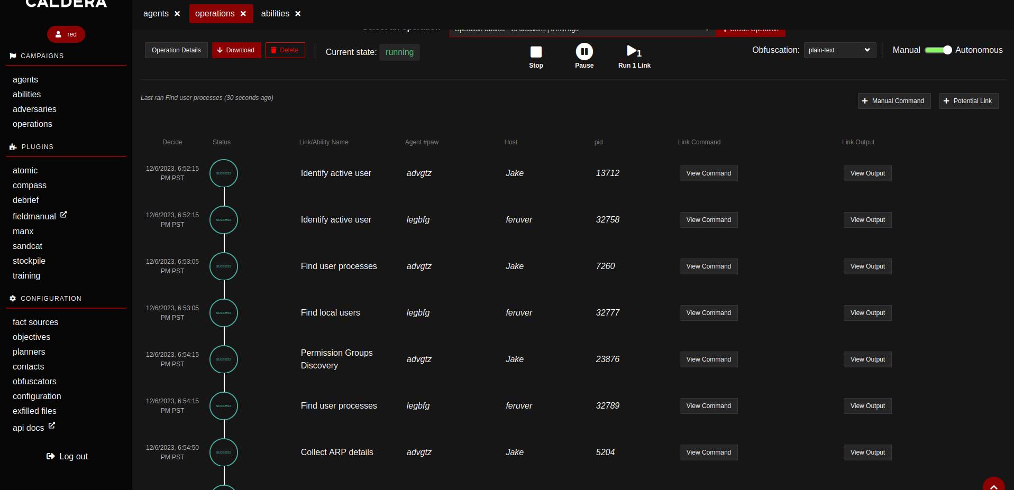
Caldera - Red Team
Running operation prompted by Red Team.

Slide 13
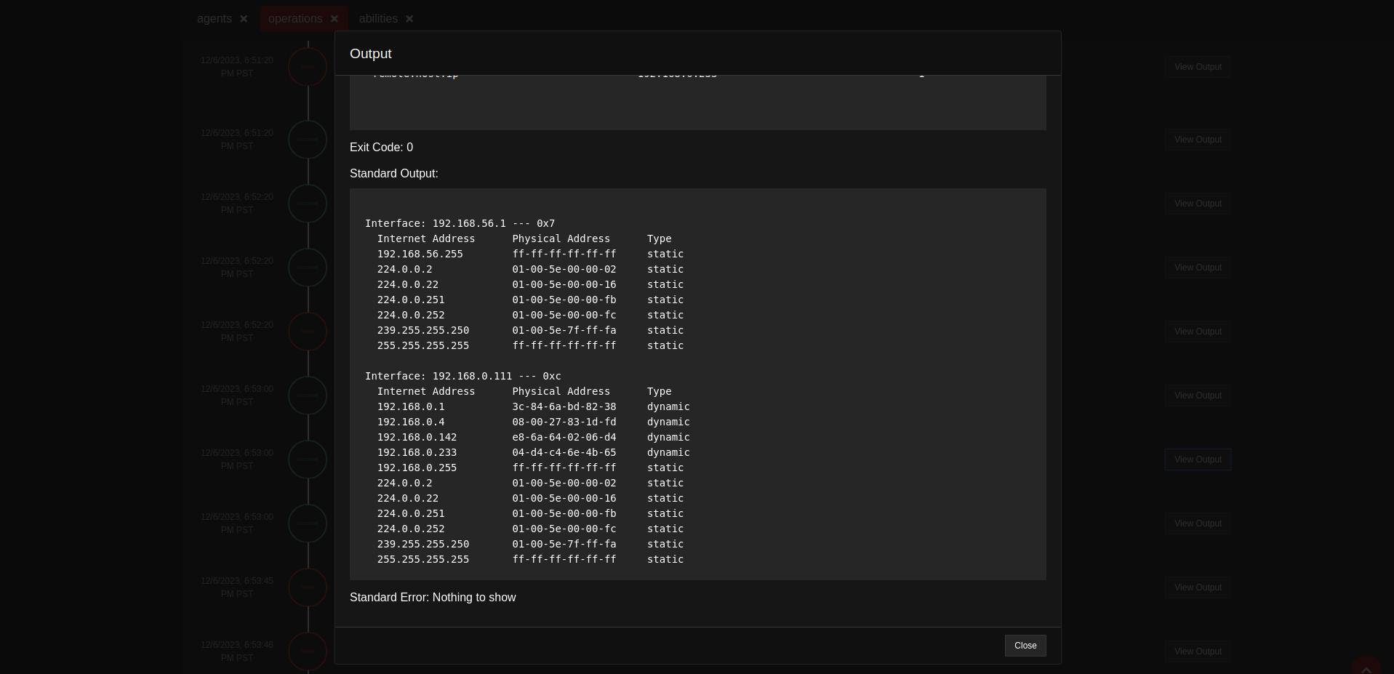
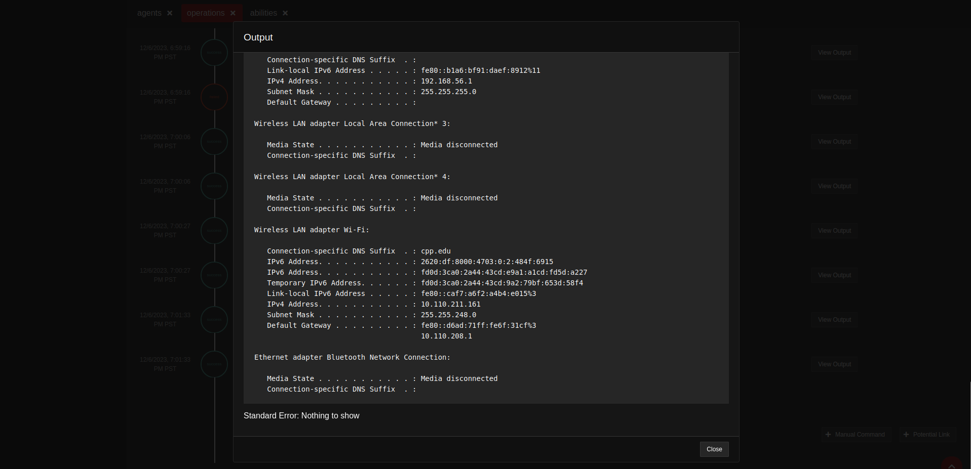
Caldera - Red Team
Network Configuration of Blue Team

Slide 14
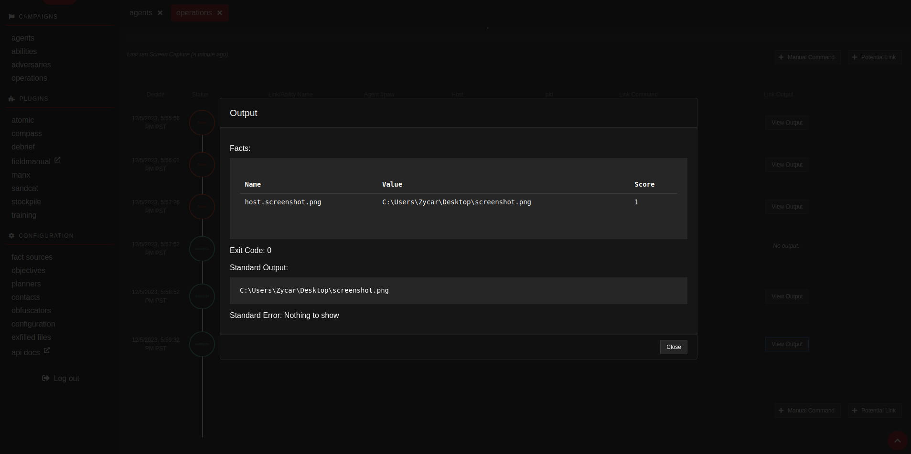
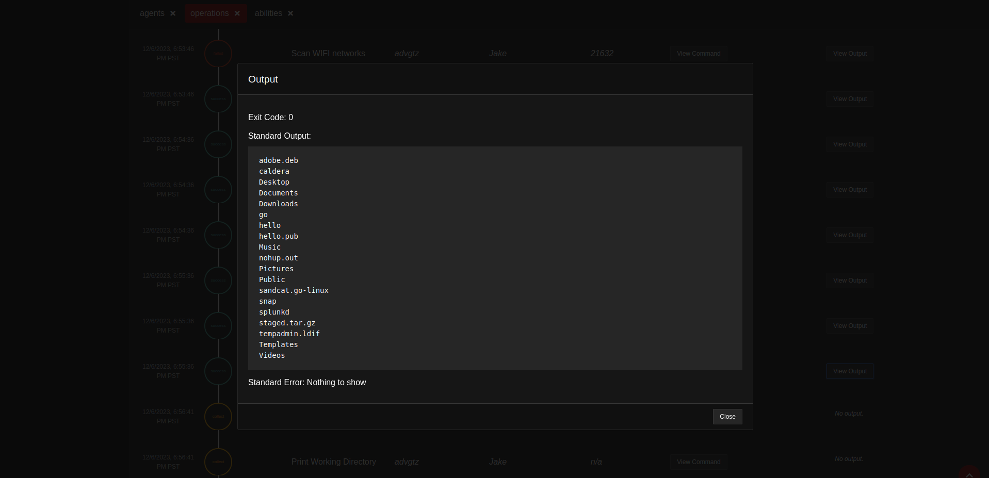
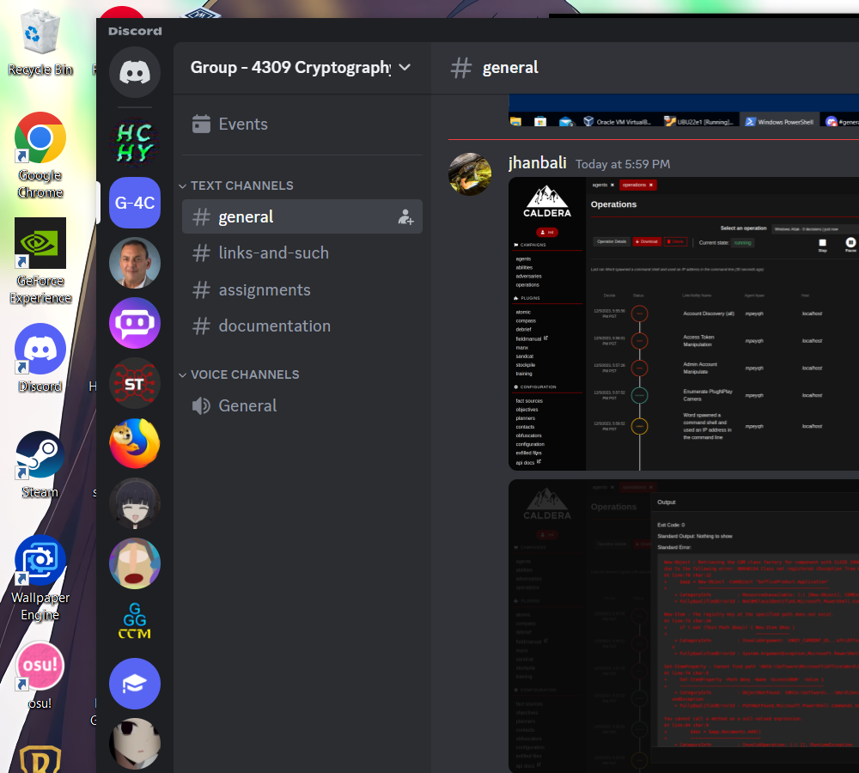
Caldera - Red Team
Above is attack to take a screenshot of target device. Right is the actual screenshot taken by Red Team.
Printing Working Directory

Slide 15
05
Blue-Team

Slide 16
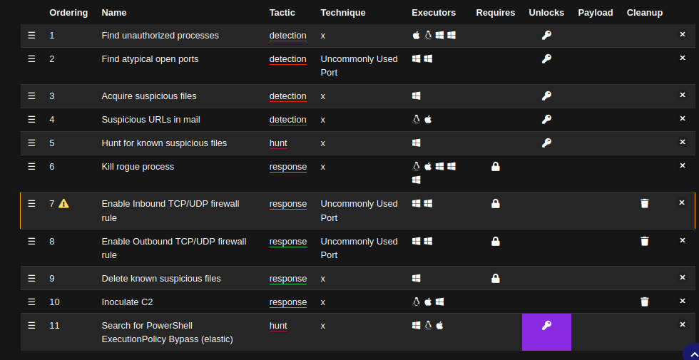
Caldera - Blue Team
Incident Responder profile by Blue Team

Slide 17
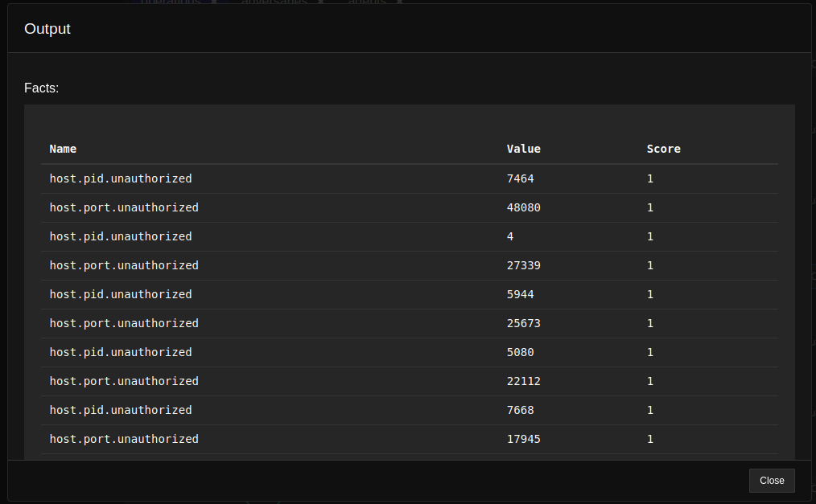
Caldera - Blue Team
Killing Unauthorized Tasks of Red Team.

Slide 18
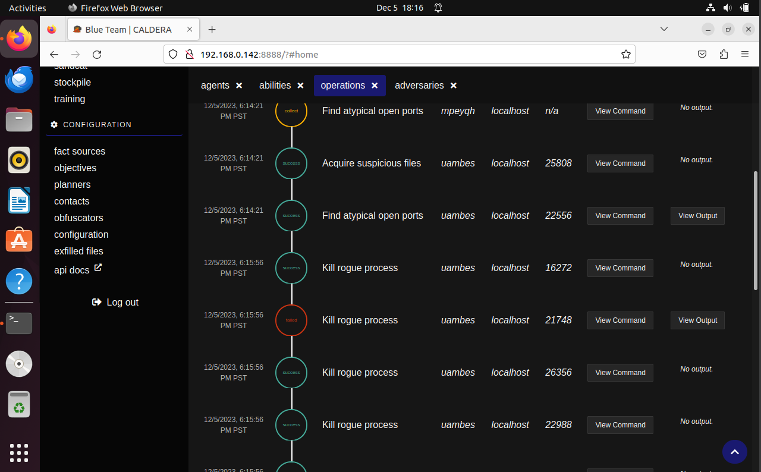
Caldera - Blue Team
Incidence Responder of Blue Team.

Slide 19
06
OSSIM SIEM

Slide 20
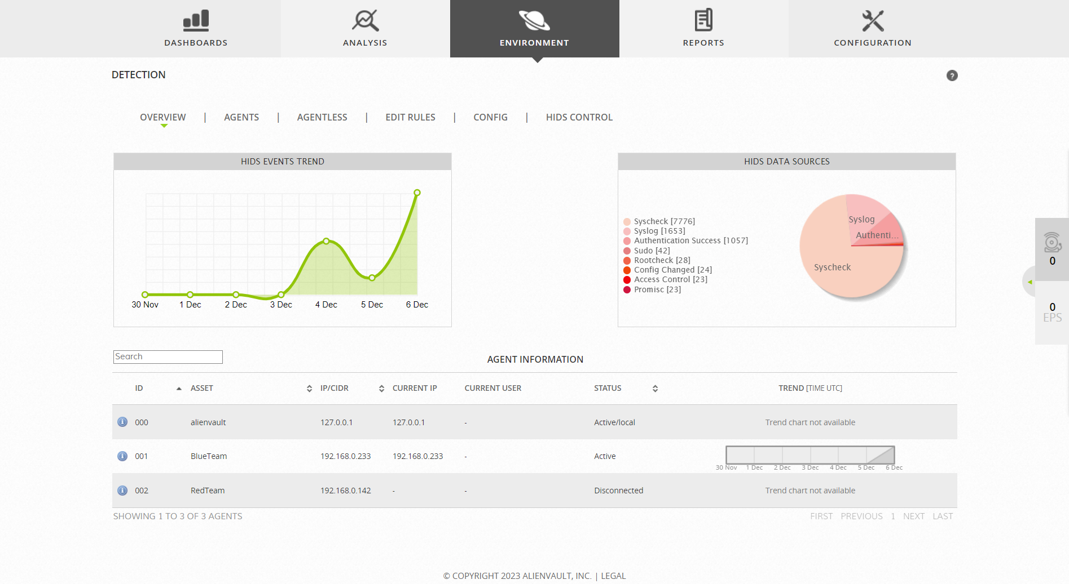
OSSIM SIEM
Detection in OSSIM SIEM.

Slide 21
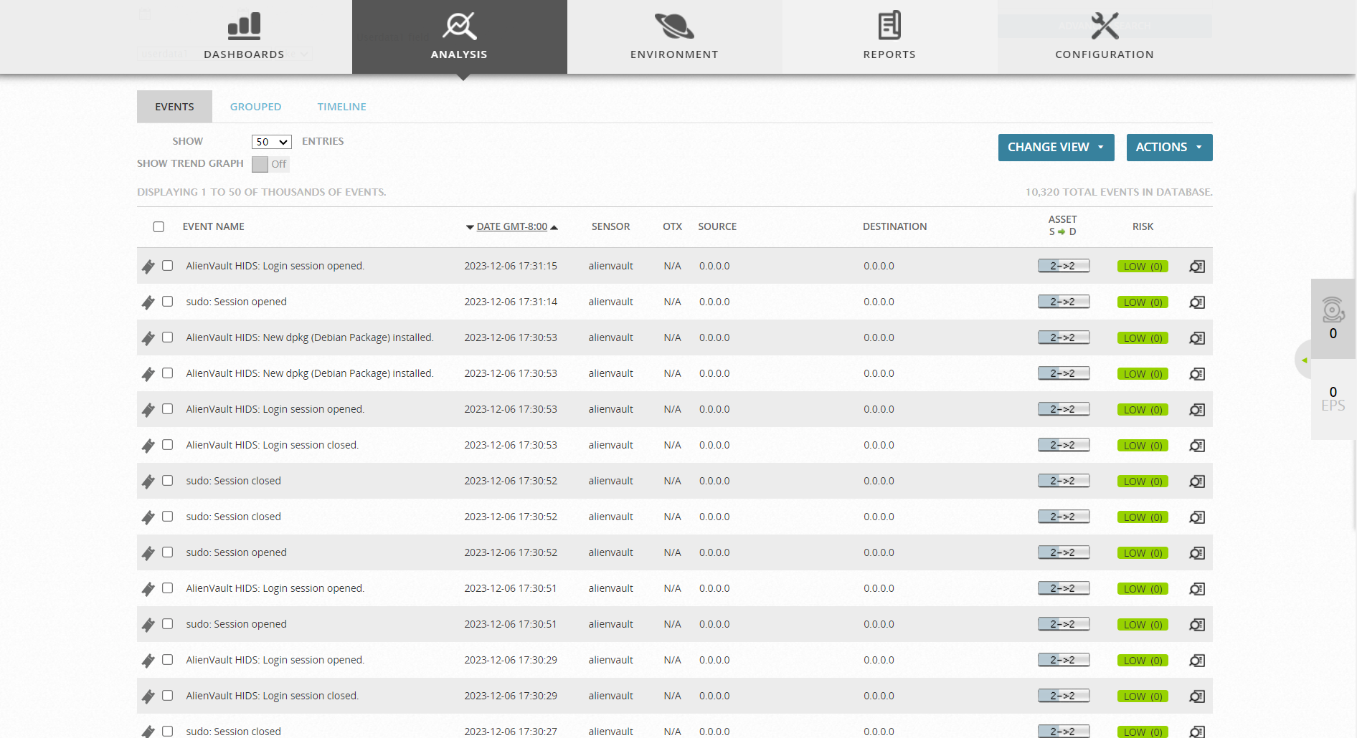
OSSIM SIEM
Event Detection in OSSIM SIEM on LOCALHOST.

Slide 22
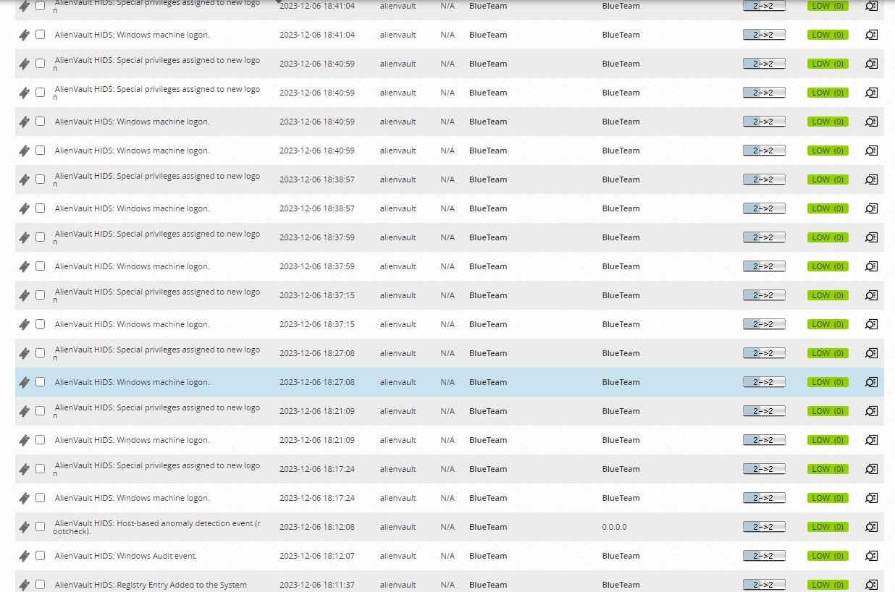
OSSIM SIEM
Event Detection in OSSIM SIEM on Blue Team.

Slide 23
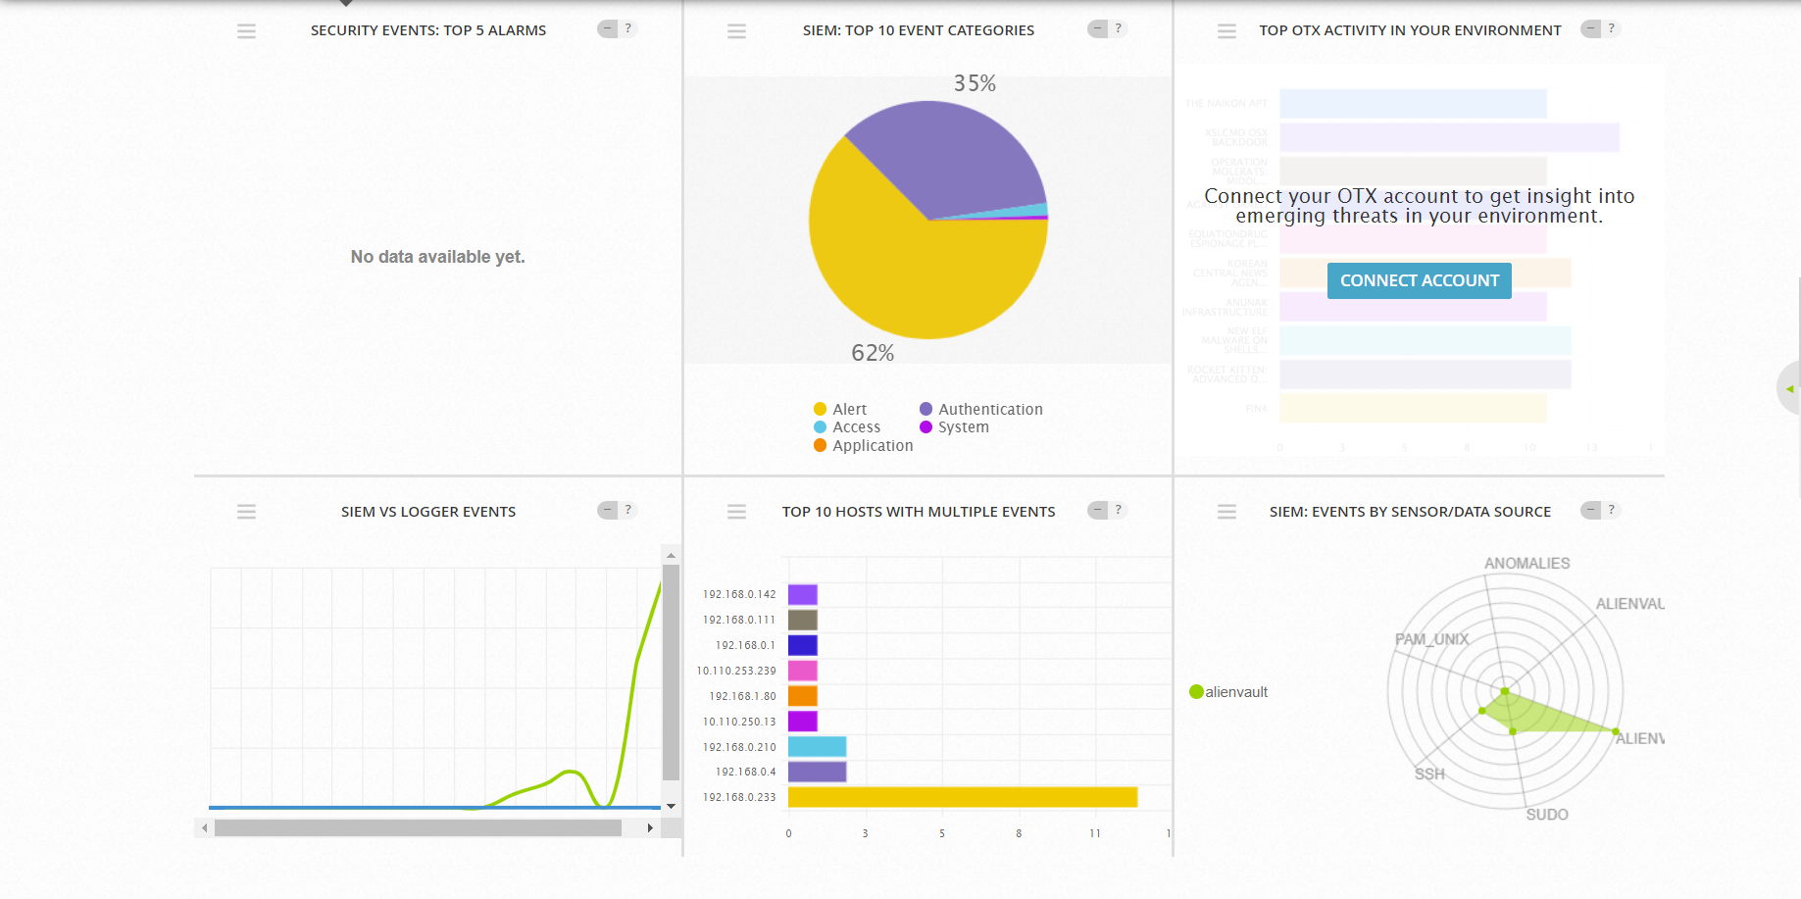
OSSIM SIEM

Slide 24
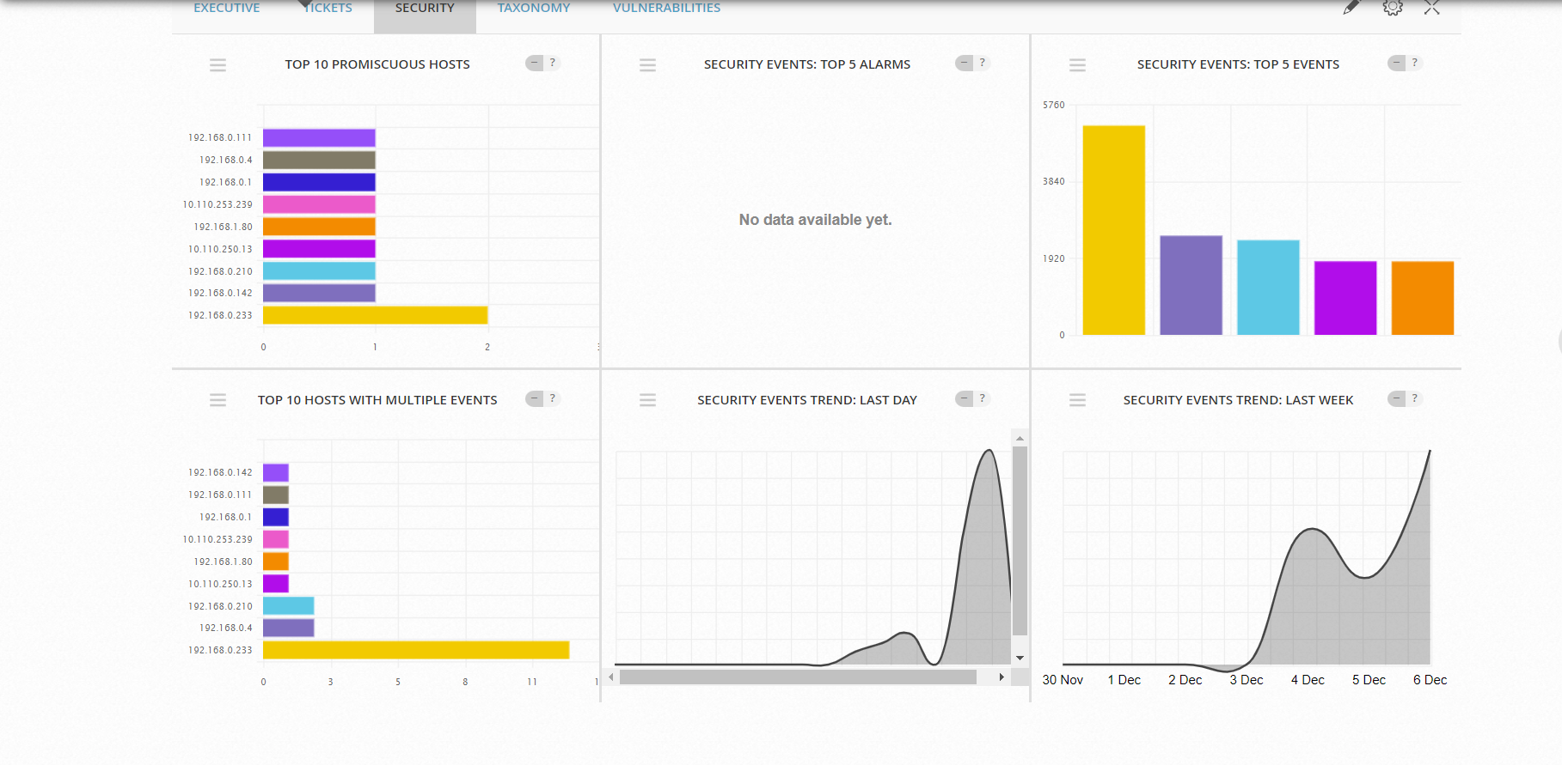
OSSIM SIEM

Slide 25
Thank You

Slide 26
References
OSSIM setup:
https://cybersecurity.att.com/documentation/usm-appliance/ids-configuration/viewing-alienvault-nids-events.htm
https://medium.com/psimss/ossim-part-1-install-ossim-on-virtualbox-e1d20f7dcbe4
https://kifarunix.com/how-to-install-and-configure-alienvault-ossim-on-virtualbox/?expand_article=1
Lazarus Group: https://mitre-attack.github.io/attack-navigator//#layerURL=https%3A%2F%2Fattack.mitre.org%2Fgroups%2FG0032%2FG0032-enterprise-layer.json

